Slide 1

INTELLIGENCE
APPLICATION
-Best way to improve your signal strength

Slide 2
Problems
Let’s see what happens when you get spotty to low signal.
01. Dropped calls
02. Poor voice quality
03. Slow Internet
04. Stuck text messages and email
05. More apps leads to less experience of coverage
You + Poor Cell Phone Signals = Silent Suffering

Slide 3
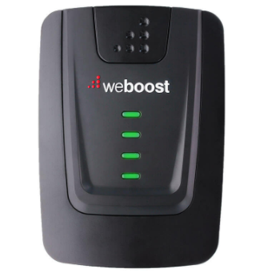
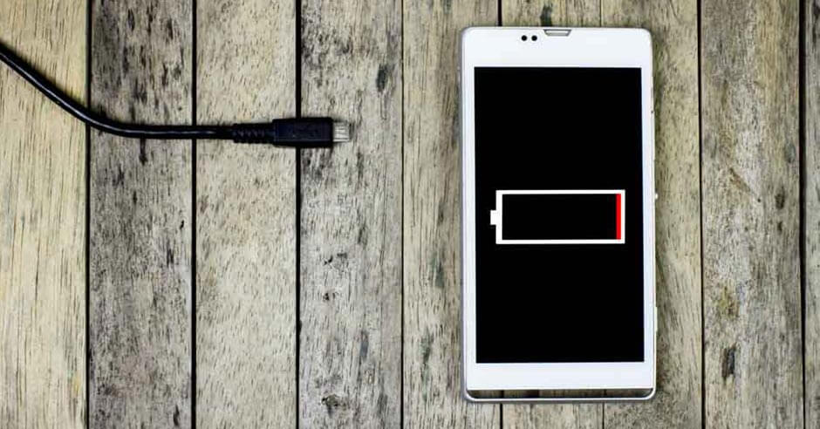
Existing Solutions
Cell phone signal boosters:
Boosts 3G & 4G LTE for any phone on any carrier.
Amplify signal.
No need to be connected to internet or WIFI to work.
Keep Your Battery Full:
Connecting to a cell tower takes a constant supply of power, so if you’re low on battery, your phone might not have enough juice to find a signal

Slide 4

Our solutions
Unlike boosters of high costs we invented a new application for boosting the signal strength which can be given as in-built application.

Slide 5
Uniqueness
Using this intelligence application,we can avoid poor signals and make better by diverting complete signal frequency strength to particular thing like calls,internet,etc...,
This app also consists of music enhancer…..

